Slide 1
ICS 2411: Cryptography
B.sc Computer Science
Name: Ashraf Mohammed Hassan Anil
Reg No: SCT211-0255/2021
12/3/2025

Slide 2

Chapter 4
Divisibility and Modular Arithmetic
ICS 2411: Cryptography
Integer Representations and Algorithms
Number Theory and Cryptography
Primes and Greatest Common Divisors
Solving Congruences
Applications of Congruences
SCT211-0255/2021
Cryptography

Slide 3
Divisibility and Modular Arithmetic
ICS 2411: Cryptography
Division of an integer by a positive integer produces a quotient and a remainder.Working with these remainders leads to modular arithmetic.
SCT211-0255/2021

Slide 4
1.1 Division
ICS 2411: Cryptography
Definition:
If a and b are integers with a = 0, we say that a divides b if there is an integer c such that b = ac, or equivalently, if b/a is an integer.
When a divides b we say that a is a factor or divisor of b, and that b is a multiple of a.
The notation a | b denotes that a divides b.We write a ∤ b
when a does not divide b.
SCT211-0255/2021

Slide 5
Example
ICS 2411: Cryptography
Let n and d be positive integers. How many positive integers not exceeding n are divisible by d?
Solution: The positive integers divisible by d are all the integers of the form dk, where k is a positive integer. Hence, the number of positive integers divisible by d that do not exceed n equals the number of integers k with 0 < dk ≤ n, or with 0 < k ≤ n/d.
Therefore, there are floor(n/d) positive integers not exceeding n that are divisible by d.
Eg: If n=20 and d=3, the numbers divisible by 3 are: 3,6,9,12,15,18
There are 20/3=6.66, so we take ⌊6.66⌋ = 6 numbers.
Thus, the answer is ⌊n/d⌋, meaning the number of integers up to n that are divisible by d.
SCT211-0255/2021

Slide 6
Theorem
ICS 2411: Cryptography
Let a, b, and c be integers, where a = 0. Then:
(i ) if a | b and a | c, then a | (b + c);
(ii ) if a | b, then a | bc for all integers c;
(iii ) if a | b and b | c, then a | c.
SCT211-0255/2021

Slide 7
1.2 The Division Algorithm
ICS 2411: Cryptography
DEFINITION:
In the equality:a = dq + r
d is called the divisor, a is called the dividend,
q is called the quotient, and r is called the remainder.
This notation is used to express the quotient and remainder:
q = a div d, r = a mod d.
SCT211-0255/2021

Slide 8
Theorem
ICS 2411: Cryptography
Let a be an integer and d a positive integer. Then there are unique integers
q and r, with 0 ≤ r < d, such that a = dq + r.
SCT211-0255/2021

Slide 9
1.3 Modular Arithmetic
ICS 2411: Cryptography
DEFINITION:
If a and b are integers and m is a positive integer, then a is congruent to b modulo m if m divides a − b. We use the notation a ≡ b (mod m) to indicate that a is congruent to b modulo m.We say that a ≡ b (mod m) is a congruence and that m is its modulus (plural moduli).
If a and b are not congruent modulo m, we write a ≢ b (mod m).
Although both notations a ≡ b (mod m) and a mod m = b include “mod,” they represent fundamentally different concepts. The first represents a relation on the set of integers, whereas the second represents a function. However, the relation a ≡ b (mod m) and the mod m function
are closely related, as described in the theorem below
SCT211-0255/2021

Slide 10
Theorem
ICS 2411: Cryptography
Let a and b be integers, and let m be a positive integer.
Then a ≡ b (mod m) if and only if
a mod m = b mod m.
SCT211-0255/2021

Slide 11
Theorem
ICS 2411: Cryptography
Let m be a positive integer. The integers a and b are congruent modulo m
if and only if there is an integer k such that a = b + km.
SCT211-0255/2021

Slide 12
Proof:
If a ≡ b (mod m), by the definition of congruence, we know that
m | (a − b). This means that there is an integer k such that a − b = km, so that a = b + km.
Conversely, if there is an integer k such that a = b + km, then km = a − b. Hence, m divides
a − b, so that a ≡ b (mod m).
The set of all integers congruent to an integer a modulo m is called the congruence class of a modulo m.
ICS 2411: Cryptography
SCT211-0255/2021

Slide 13
Theorem
ICS 2411: Cryptography
Let m be a positive integer. If a ≡ b (mod m) and c ≡ d (mod m), then
a + c ≡ b + d (mod m) and ac ≡ bd (mod m).
Proof:We use direct proof. Because a ≡ b (mod m) and c ≡ d (mod m), by Theorem in slide 14 there
are integers s and t with b = a + sm and d = c + tm. Hence,
b + d = (a + sm) + (c + tm) = (a + c) + m(s + t)
and
bd = (a + sm)(c + tm) = ac + m(at + cs + stm).
Hence,
a + c ≡ b + d (mod m) and ac ≡ bd (mod m).
SCT211-0255/2021

Slide 14
1.5 Arithmetic Modulo M
ICS 2411: Cryptography
We can define arithmetic operations on Zm, the set of nonnegative integers less than m, that is, the set {0, 1, . . . , m − 1}. In particular, we define addition of these integers, denoted by +m by
a +m b = (a + b) mod m,
where the addition on the right-hand side of this equation is the ordinary addition of integers, and we define multiplication of these integers, denoted by ·m by
a ·m b = (a · b) mod m,
where the multiplication on the right-hand side of this equation is the ordinary multiplication of integers. The operations +m and ·m are called addition and multiplication modulo m and when
we use these operations, we are said to be doing arithmetic modulo m.
SCT211-0255/2021

Slide 15
Example
ICS 2411: Cryptography
Use the definition of addition and multiplication in Zm to find 7 +11 9 and 7 ·11 9.
Solution: Using the definition of addition modulo 11, we find that:
7 +11 9 = (7 + 9) mod 11 = 16 mod 11 = 5,
And
7 ·11 9 = (7 · 9) mod 11 = 63 mod 11 = 8.
Hence 7 +11 9 = 5 and 7 ·11 9 = 8.
SCT211-0255/2021

Slide 16
2. Representations of Integers
ICS 2411: Cryptography
Integers can be expressed using any integer greater than one as a base.Although we commonly use decimal (base 10), representations, binary (base 2), octal (base 8), and hexadecimal (base 16) representations are often used, especially in computer science.
SCT211-0255/2021

Slide 17
Theorem
ICS 2411: Cryptography
Let b be an integer greater than 1. Then if n is a positive integer, it can be expressed uniquely
in the form
n = a_{k}b_{k} + a_{k-1}b_{k-1} +· · ·+a₁b + a₀,
where k is a nonnegative integer, a₀, a₁, . . . , a_{k} are nonnegative integers less than b, and
a_{k} = 0.
SCT211-0255/2021

Slide 18
2.1.1 BINARY EXPANSIONS
2.1.2 OCTAL AND HEXADECIMAL EXPANSIONS
ICS 2411: Cryptography
Choosing 2 as the base gives binary expansions of integers. In
binary notation each digit is either a 0 or a 1. In other words, the binary expansion of an integer is just a bit string. Binary expansions (and related expansions that are variants of binary expansions) are used by computers to represent and do arithmetic with integers.
Among the most important bases are base 2, base 8, and base 16. Base 8 expansions are called octal expansions and base 16 expansions are hexadecimal expansions.
SCT211-0255/2021

Slide 19
2.2 BASE CONVERSION
ICS 2411: Cryptography
EXAMPLE:
Find the octal expansion of (12345)₁₀.
Solution: First, divide 12345 by 8 to obtain
12345 = 8 · 1543 + 1.
Successively dividing quotients by 8 gives
1543 = 8 · 192 + 7,
192 = 8 · 24 + 0,
24 = 8 · 3 + 0,
3 = 8 · 0 + 3.
The successive remainders that we have found, 1, 7, 0, 0, and 3, are the digits from the right to the left of 12345 in base 8. Hence,
(12345)₁₀ = (30071)₈
SCT211-0255/2021

Slide 20
2.3 Algorithms for Integer Operations
ICS 2411: Cryptography
2.3.1 ADDITION ALGORITHM
Qn: Add a=(1110)₂ and b=(1011)₂
using the binary addition algorithm.
Final Result
We now have:
1110
+ 1011
------------
11001
SCT211-0255/2021

Slide 21
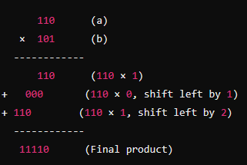
2.3 Algorithms for Integer Operations
ICS 2411: Cryptography
2.3.2 MULTIPLICATION ALGORITHM
multiply a=(110)₂​ and b=(101)₂
SCT211-0255/2021

Slide 22
2.4 Modular Exponentiation
ICS 2411: Cryptography
What is Modular Exponentiation?
Modular exponentiation is a technique used in cryptography to efficiently compute large exponents in modular arithmetic. Instead of computing b^{n} first and then finding b^{n} mod m, we use a step-by-step method that keeps the numbers manageable by reducing modulo mmm at each step.
Why is it Useful?
Computing b^{n} directly for large n results in extremely large numbers, making calculations impractical. Modular exponentiation allows us to compute b^{n} mod m efficiently, which is crucial for encryption systems like RSA.
SCT211-0255/2021

Slide 23
3. Primes and Greatest Common Divisors
ICS 2411: Cryptography
An integer p greater than 1 is called prime if the only positive factors of p are 1 and p.
A positive integer that is greater than 1 and is not prime is called composite.
GCD: The largest number that divides two numbers
SCT211-0255/2021

Slide 24
Fundamental Theorem of Arithmetic
ICS 2411: Cryptography
Every integer greater than 1 can be written uniquely as a prime or as the product of two or more primes where the prime factors are written in order of nondecreasing size.
Eg:
12 = 2 × 2 × 3
30 = 2 × 3 × 5
SCT211-0255/2021

Slide 25
3.1 Finding Prime Numbers
ICS 2411: Cryptography
Trial Division: Check if a number is divisible by any prime up to its square root (√n).
Eg:
Example: Is 101 prime?
√101≈10
so we check divisibility by primes ≤ 10: 2, 3, 5, 7.
101 is not divisible by any of these, so 101 is prime.
Sieve of Eratosthenes: A method for finding all primes up to a given number by progressively eliminating multiples of smaller primes.
Eg:
Find primes up to 30
Start with: 2, 3, 4, 5, 6, 7, 8, 9, 10, …, 30
Cross out multiples of 2 → 4, 6, 8, 10, 12, …
Cross out multiples of 3 → 9, 12, 15, 18, …
Cross out multiples of 5 → 25, 30…
The remaining numbers (2, 3, 5, 7, 11, 13, 17, 19, 23, 29) are prime numbers.
SCT211-0255/2021

Slide 26
3.2 Special Types of Primes
ICS 2411: Cryptography
Mersenne Primes: Primes of the form 2^{p}−1 where p is also prime (e.g., 3, 7, 31, 127).
EXAMPLE:
The number:
3 = 2² -1, 7 = 2³ - 1, 31 = 2⁵- 1…
are Mersenne primes,
while 2¹¹ − 1 = 2047 is not a Mersenne prime because 2047 = 23 · 89.(showing that 2047 has the factors 23 and 89) even though it satisfies the form 2^{p}−1
Infinitely Many Primes: Euclid's proof shows that primes never run out.
Proof:We will prove this theorem using a proof by contradiction.We assume that there are only
finitely many primes, p1, p2, . . . , pn.
Let Q = p1 p2 · · · pn + 1.
By the fundamental theorem of arithmetic, Q is prime or else it can be written as the product of two or more primes. However, none of the primes pj divides Q, for if pj | Q, then pj divides Q − p1p2 · · · pn = 1.
Hence, there is a prime not in the list p1, p2, . . . , pn. This prime is either Q, if it is prime, or a prime factor of Q. This is a contradiction because we assumed that We have listed all the primes. Consequently, there are infinitely many primes.
SCT211-0255/2021

Slide 27
3.3 GCD and LCM
ICS 2411: Cryptography
GCD: The largest number that divides two numbers (e.g., GCD(12,18) = 6).
LCM: The smallest number that is a multiple of both numbers (e.g., LCM(12,18) = 36).
Euclidean Algorithm: A fast method to compute GCD using repeated division.
The algorithm repeatedly applies the division rule:
If a=bq+r then gcd(a, b) = gcd(b, r).
This process continues until the remainder is 0, and the last nonzero remainder is the GCD.
SCT211-0255/2021

Slide 28
3.4 Bézout’s Theorem
ICS 2411: Cryptography
If a and b are positive integers, then there exist integers s and t such that gcd(a, b) = sa + tb.
Bézout’s Identity & Coefficients
If two positive integers, a and b, have a greatest common divisor (gcd), there exist integers s and t such that: gcd⁡(a,b)=sa+tb
These integers s and t are called Bézout coefficients
SCT211-0255/2021

Slide 29
4. Solving Congruences
ICS 2411: Cryptography
4.1 linear congruence
A linear congruence is an equation of the form: ax≡b(mod m)
Where: a,b and m are integers, x is the unknown we need to find
Used to Find the modular inverse of a(if it exists),
eg:
Solve:
3x≡4(mod7)
Find the inverse of 3 modulo 7: It's 5 (since 3×5=15≡1(mod7) )
Multiply both sides by 5: x≡5×4=20≡6(mod7)
Solutions: x≡6(mod7) (i.e., x=6,13,20,…).
SCT211-0255/2021

Slide 30
4.2 The Chinese Remainder Theorem (CRT)
ICS 2411: Cryptography
If we have a system of congruences:
x≡a₁(mod m₁)
x≡a₂(modm₂)
...
x≡a_{n}(mod m_{n})
where all m_{i} are pairwise relatively prime, then there is a unique solution modulo M=m₁m₂…m_{n}
SCT211-0255/2021

Slide 31
4.3 Computer Arithmetic with Large Integers
ICS 2411: Cryptography
Instead of working directly with large numbers, we break them into smaller parts using remainders (modulo operations). This allows us to perform calculations using smaller numbers and then recombine the results to get the final answer.
In the following ways:
Representing Large Numbers with Remainders
Adding Large Numbers Using Remainders
In Choosing Good Moduli for Computers
SCT211-0255/2021

Slide 32
4.4 Fermat’s Little Theorem
If p is a prime number and a is any whole number that is not divisible by p, then:
a^{p−1}≡1 (mod p)
This means that when you divide a^{p−1} by p, the remainder will always be 1.
ICS 2411: Cryptography
A second version of the theorem states that:
for any integer a, whether or not it’s divisible by ppp:
a^{p}≡a (mod p)
This means that raising a to the power of p and then dividing by p gives the same remainder as just dividing a by p
SCT211-0255/2021

Slide 33
4.5 Pseudoprimes
ICS 2411: Cryptography
Fermat’s Little Theorem: If n is prime, then for any number b, raising b to n−1 and dividing by n should always leave a remainder of 1.
The Problem: Some composite numbers (not prime) also satisfy this rule, falsely appearing prime—these are called pseudoprimes.
Example: 341 is composite (11×31), but it passes Fermat’s test for base 2, making it a pseudoprime.
Carmichael Numbers: Special pseudoprimes that fool Fermat’s test for all bases (e.g., 561).
SCT211-0255/2021

Slide 34
4.6.1 Primitive Roots
A primitive root of a prime p is a number r that, when raised to different powers modulo p, generates all numbers from 1 to p−1.
Example: For p=11, 2 is a primitive root because:
2¹=2,2²=4,2³=8,2⁴=5,…,2¹⁰=1
This sequence includes all numbers from 1 to 10, meaning 2 is a primitive root modulo 11.
4.6.2 Discrete Logarithms
The discrete logarithm is the reverse of exponentiation in modular arithmetic.
Example: If
2⁸≡3 mod 11
then the discrete logarithm of 3 to base 2 (mod 11) is 8, written as:
log⁡₂3=8 mod 11
Importance: Discrete logarithms are hard to compute for large numbers, making them useful for cryptography (e.g., Diffie-Hellman key exchange).
ICS 2411: Cryptography
SCT211-0255/2021

Slide 35
5. Applications of Congruences
ICS 2411: Cryptography
Hashing Functions
Pseudorandom Number Generation
Check Digits
How congruences help assign memory locations efficiently.
Using modular arithmetic to create random-like sequences.
Ensuring accuracy in identification numbers.
SCT211-0255/2021

Slide 36
6. Cryptography
ICS 2411: Cryptography
Cryptography is the practice of securing information so that only intended recipients can understand it.
It has been used for thousands of years, initially with simple substitution techniques like the Caesar cipher.
Modern cryptography is heavily based on number theory, particularly modular arithmetic and prime numbers.
SCT211-0255/2021

Slide 37
6.1 Types of Cryptographic Systems
ICS 2411: Cryptography
Private Key Cryptography
Also called symmetric cryptography.
The sender and receiver share a single secret key for both encryption and decryption.
Examples:
Shift Cipher: Each letter in a message is shifted by a fixed number of places.
Affine Cipher: A more complex mathematical function is used to encrypt text.
Key Challenge: The secure exchange of secret keys between parties.
Public Key Cryptography
Introduced in the 1970s to overcome key exchange problems.
Involves two keys:
Public Key: Used for encryption and can be shared openly.
Private Key: Used for decryption and must be kept secret.
Example: RSA Cryptosystem (discussed below).
Pros & Cons:
Eliminates the need for secure key exchange.
Slower compared to private key cryptography.
SCT211-0255/2021

Slide 38
6.2 The RSA Cryptosystem
ICS 2411: Cryptography
Based on modular arithmetic and the difficulty of factoring large prime numbers.
Key components:
Choose two large prime numbers, p and q.
Compute n=p×q.
Select a public key exponent eee, relatively prime to (p−1)(q−1).
Compute the private key exponent d as the modular inverse of eee.
Encryption: C=Me mod n.
Decryption: M=C^{d} mod n.
Security Basis: Factoring n back into p and q is extremely hard with current computing power.
SCT211-0255/2021

Slide 39
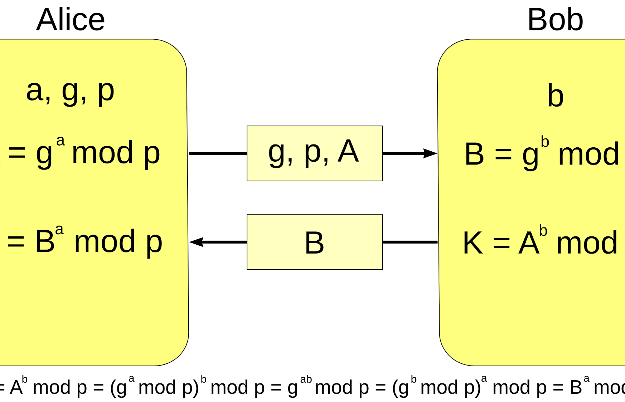

6.3 Cryptographic Protocols
ICS 2411: Cryptography
Key Exchange - Diffie-Hellman Protocol
Digital Signatures
Allows two parties to create a shared secret key over an insecure channel.
Uses modular arithmetic to prevent an attacker from deducing the key.
Security Basis: The difficulty of solving the discrete logarithm problem.
Used to verify the authenticity of a message sender.
Involves encrypting a hash of the message with the sender’s private key.
The recipient decrypts it using the sender’s public key.
Ensures message integrity and authenticity.
SCT211-0255/2021

Slide 40
6.4 Homomorphic Encryption
ICS 2411: Cryptography
Allows computations on encrypted data without decrypting it.
Useful in cloud computing, where data security is critical.
Example: The RSA cryptosystem allows multiplication of encrypted values without decryption.
Fully Homomorphic Encryption (FHE): A theoretical system allowing both addition and multiplication on encrypted data.
The End
SCT211-0255/2021

